Slide 1
Accelerate your development with Experience Manager Core Components

Slide 2
1 | Welcome and Overview
2 | Core Components
3 | Web team workflow
4 | Lab overview
5 | High-level overview of each chapter

Slide 3
why
core components
?

Slide 4
core components | why?
built by AEM engineers
API based on best practices
web development team speaks the same language

Slide 5
core components | why?
front-end developers
AEM developers
presentation layer
engage front-end teams in UI work

Slide 6
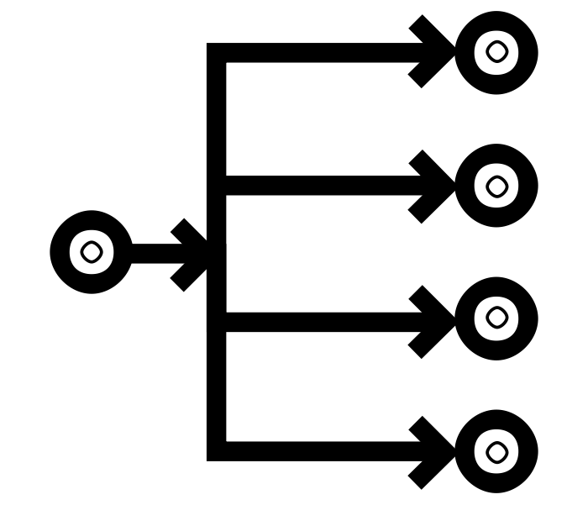
core components | why?
styling reduces number of components

Slide 7

workflow
1
front end developer reviews the HTML generated by the component(s), this informs the creation of the CSS and JavaScript

Slide 8
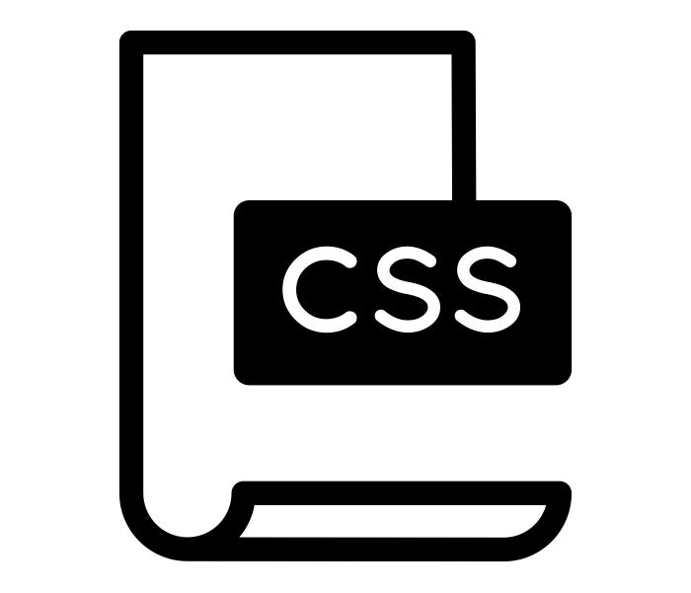
workflow
2
front-end developer builds CSS and JavaScript targeting the component HTML and documents in the style guide

Slide 9
workflow
3
release manager deploys the new CSS and JavaScript to AEM

Slide 10
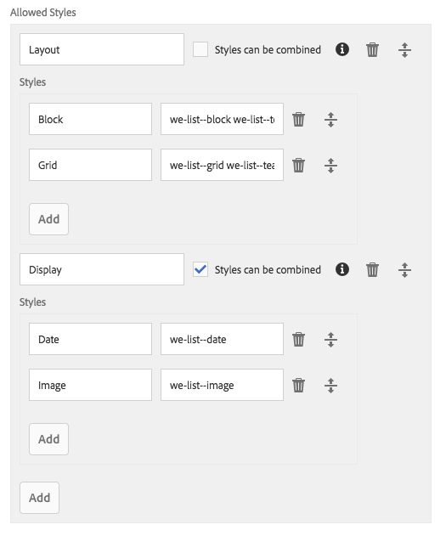
workflow
4
web producer use the style guide to define available styles for the content authors

Slide 11
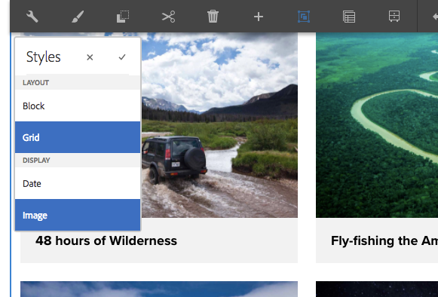
workflow
5
experience author can now apply the styles while authoring web pages

Slide 12
Core Components
page
breadcrumb
title
text
image
list
sharing
navigation
language navigation
quick search
form container
form text field
form options field
form hidden field
form button
teaser (sandbox)

Slide 13
Core Components
page
breadcrumb
title
text
image
list
sharing
navigation
language navigation
quick search
form container
form text field
form options field
form hidden field
form button
teaser (sandbox)

Slide 14
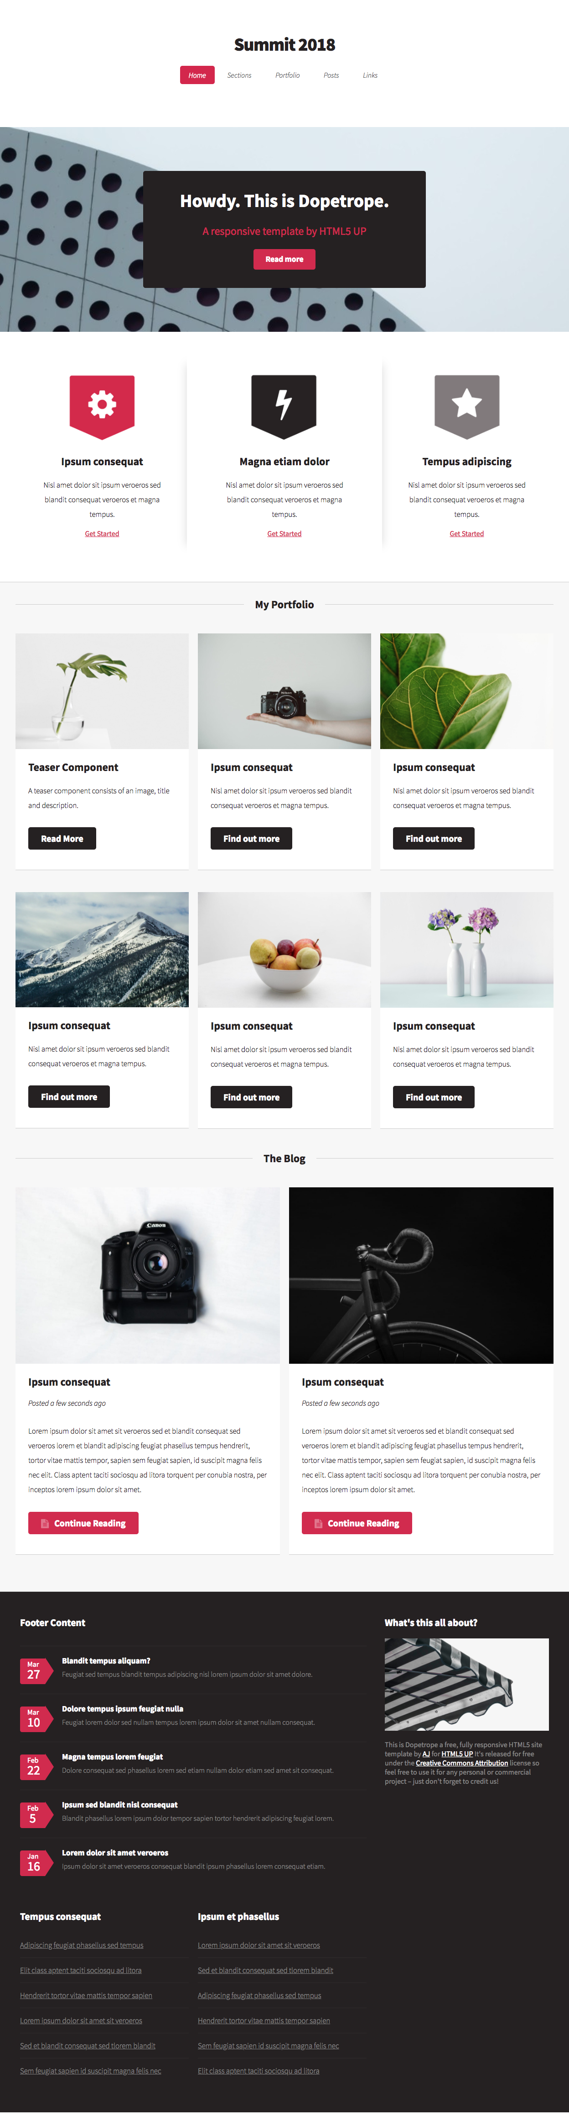
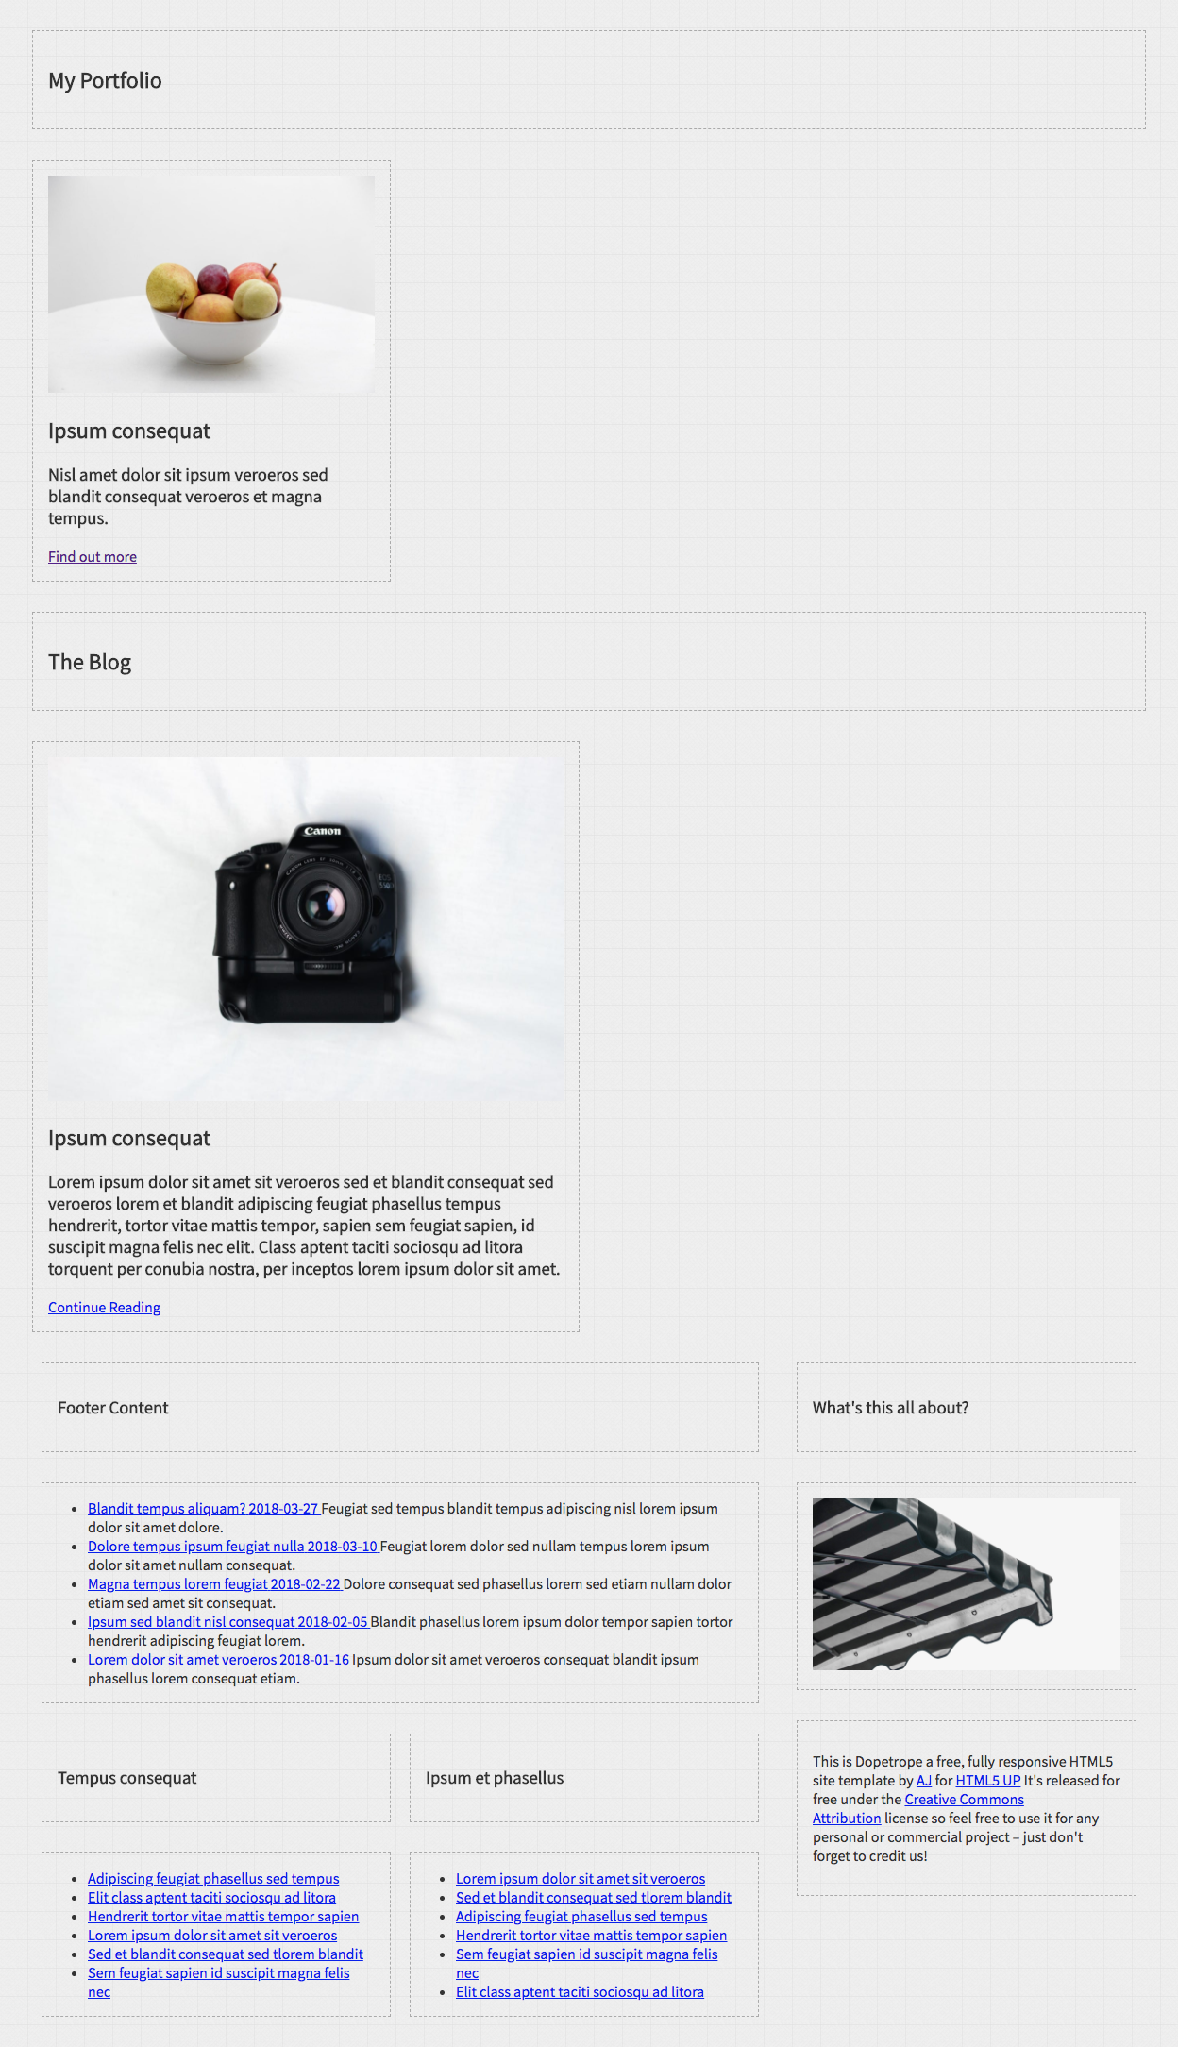

Slide 15
Chapter 0

Slide 16
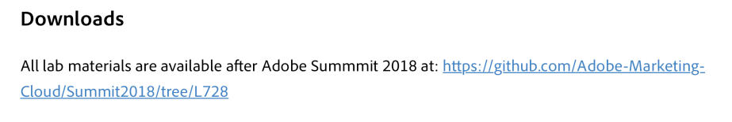
Corrections ☹
The Lab Book contains the wrong Git repository link to download lab materials.
→ L725

Slide 17
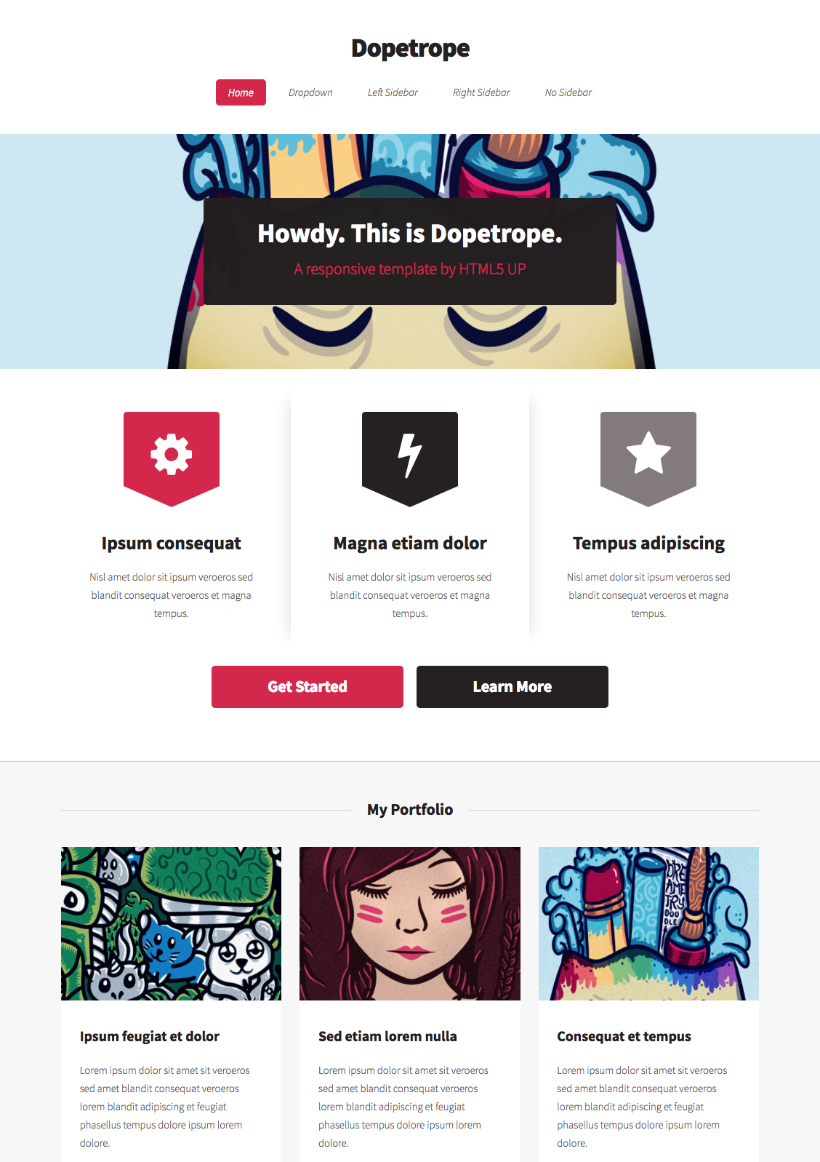
Dopetrope?
What?!
Dopetrope is a Web site theme available at HTML5up.net
Why?!
HTML5up is unaffiliated with Experience Manager, and not predisposed to its design paradigms.
The design is simple to understand, yet representative of a modern web aesthetic.
Most importantly, its fun saying "Dopetrope”.
http://html5up.net/dopetrope

Slide 18
No Magic!
Core Components v2 + Core Teaser Component
Proxy Core Components for Dopetrope
A Wireframe theme
The Dopetrope theme (LESS/CSS and JS)
Use of LESS
Lightly pre-configured Homepage Editable Template
Some image assets and a few content pages.
No Java or HTL was written in the making of this lab.

Slide 19
Chapter 1
Core Components

Slide 20
Core Components and the Style System
Core Component v1
Include AEM styletab in proxy component’s cq:design_dialog.
Core Component v2
Integrated OOTB.
Custom Components
Include AEM styletab in component’s cq:design_dialog.
/apps/my-app/components/my-component/cq:design_dialog/content/items/tabs/items/styletab
@path = /mnt/overlay/cq/gui/components/authoring/dialog/style/tab_design/styletab
@sling:resourceType = granite/ui/components/coral/foundation/include

Slide 21
Proxy of Core Components
Always proxy Core Components into your code base.
/apps/l725/components/title
@jcr:primaryType = cq:Component
@sling:resourceSuperType = core/wcm/components/title/v2/title

Slide 22
Chapter 2
The Page Template

Slide 23
Editable Templates
Defines layout and structure for pages
Policies provide granular control over component behavior
No coding
Header
header
Header
Container
footer
Footer
footer
Footer
Editable Template
Web Pages

Slide 24
Chapter 3
Content-first Authoring

Slide 25
Content-first Authoring
Core Components are ready for authoring content.
Developers can work on style and brand implementation.
Both activities can occur in parallel.
Content
Finished
Web site
Authors
Styles
Developers

Slide 26
Chapter 4
AEM Client Libraries

Slide 27
Client Libraries
Organize CSS/JS files into discrete, logical groups.
Pack CSS/JS to minimize Web browser requests.
Compile LESS to CSS.
Minify and Gzip CSS/JS.
CSS
Web
page
LESS
Web browser
JS
JS
Client library

Slide 28
LESS and to CSS
.cmp-title--section {
.cmp-title {
color: @primaryColor;
.cmp-title__text {
font-weight: 400;
}
}
}
LESS
…compiles to…
.cmp-title--section .cmp-title {
color: red;
}
.cmp-title--section .cmp-title .cmp-title__text {
font-weight: 400;
}
CSS
Notes:
Less is a backwards-compatible language extension for CSS

Slide 29
Our Client Libraries
Client Libraries organize our front-end assets to support the Dopetrope site implementation.
The LESS/JS we wrote to implement the Dopetrope brand.
Brand & component styles, responsive grid definition and functional JS.
Assigned category l725.dopetrope.
Clientlibs are assigned categories and are referenced by said categories.
Clientlibs belong in /apps not /etc/clientlibs!
/apps/l725/clientlibs/…
clientlib-dopetrope
/apps/l725/clientlibs/…
clientlib-dopetrope

Slide 30
Component Styles
A Component’s LESS/JS, organized by convention.
Our Dopetrope styled Title Component
Default, Section and Site styles
No JS (told you it was rare!)
A set of LESS/CSS defining the respective Component style.
Try to define a file per style.
ex. section-title.less, hero.less
Defines the default Component style.
A single LESS file used to organize imports of other LESS style files.
Has few styles of its own.
JS to support Component styling is managed in a single file.
Requiring JS to support a style is rare.
Each Component has its own folder to organize its style’s LESS/JS.
/apps/l725/clientlibs/clientlib-dopetrope/components
…/title/title.less
…/title/styles/default.less
…/title/styles/section.less
…/title/styles/site.less
/apps/l725/clientlibs/clientlib-dopetrope/components
…/component-x/component-x.js
…/component-x/component-x.less
…/component-x/styles/default.less
…/component-x/styles/style-a.less
…/component-x/styles/style-b.less
/apps/l725/clientlibs/clientlib-dopetrope/components
…/component-x/component-x.js
…/component-x/component-x.less
…/component-x/styles/default.less
…/component-x/styles/style-a.less
…/component-x/styles/style-z.less
/apps/l725/clientlibs/clientlib-dopetrope/components
…/component-x/component-x.js
…/component-x/component-x.less
…/component-x/styles/default.less
…/component-x/styles/style-a.less
…/component-x/styles/style-b.less
/apps/l725/clientlibs/clientlib-dopetrope/components
…/component-x/component-x.js
…/component-x/component-x.less
…/component-x/styles/default.less
…/component-x/styles/style-a.less
…/component-x/styles/style-b.less
/apps/l725/clientlibs/clientlib-dopetrope/components
…/component-x/component-x.js
…/component-x/component-x.less
…/component-x/styles/default.less
…/component-x/styles/style-a.less
…/component-x/styles/style-b.less

Slide 31
Chapter 6
CSS Based Styles

Slide 32
HTML as an API
Core Components use BEM (Block Element Modifier) to define a stable API.
… so should you!
MODIFIER cmp-title--section
BLOCK cmp-title
ELEMENT cmp-title__text
<div class="cmp-title--section">
<div class="cmp-title">
<h3 class="cmp-title__text">
My Title
</h3>
</div>
</div>

Slide 33
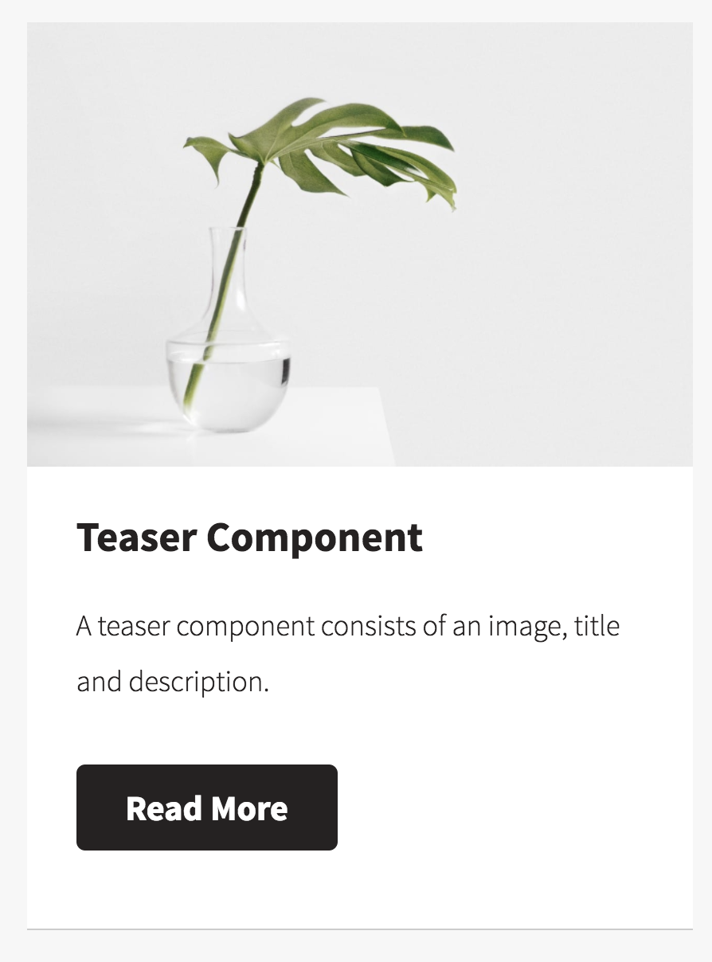
CSS (LESS) for Styles
BLOCK represents the Component.
BLOCK__ELEMENT represents some logical "part" of the component (hyperlink, text, image, etc.)
BLOCK--MODIFIER represents a Component Style.
cmp-teaser
cmp-teaser__image
cmp-image
cmp-image__image
cmp-teaser__title
cmp-teaser__description
cmp-teaser__link
cmp-teaser
cmp-teaser__image
cmp-image
cmp-image__image
cmp-teaser__title
cmp-teaser__description
cmp-teaser__link
cmp-teaser
cmp-teaser__image
cmp-image
cmp-image__image
cmp-teaser__title
cmp-teaser__description
cmp-teaser__link
cmp-teaser
cmp-teaser__image
cmp-image
cmp-image__image
cmp-teaser__title
cmp-teaser__description
cmp-teaser__link
cmp-teaser
cmp-teaser__image
cmp-image
cmp-image__image
cmp-teaser__title
cmp-teaser__description
cmp-teaser__link
cmp-teaser
cmp-teaser__image
cmp-image
cmp-image__image
cmp-teaser__title
cmp-teaser__description
cmp-teaser__link
cmp-teaser--portfolio
cmp-teaser
cmp-teaser__image
cmp-image
cmp-image__image
cmp-teaser__title
cmp-teaser__description
cmp-teaser__link

Slide 34
Teaser with Portfolio Style: HTML
<div class="teaser cmp-teaser--portfolio ... aem-GridColumn--default--4">
<div class="cmp-teaser">
<div class="cmp-teaser__image">
<div class="cmp-image">
<img src="/content/…/_jcr_content/root/responsivegrid/teaser.img.jpeg"
class="cmp-image__image"/>
</div>
</div>
<h2 class="cmp-teaser__title">Teaser Component</h2>
<h3 class="cmp-teaser__description">A teaser component consists of ...</h3>
<a class="cmp-teaser__link" href="#">Read More</a>
</div>

Slide 35
Teaser with Portfolio Style: LESS
/apps/l725/clientlibs/clientlib-dopetrope/components/teaser/styles/portfolio.less
.cmp-teaser--portfolio { <-- BLOCK--MODIFIER (Component Style)
.cmp-teaser { <-- BLOCK (Component)
border-style: solid;
...
.cmp-teaser__image { <-- BLOCK__ELEMENT (Component's Image)
position: relative;
...
}
...
.cmp-teaser__link { <-- BLOCK__ELEMENT (Component's Link)
display: block;
...
}
}
}

Slide 36
The Default Style
Helpful to explicitly scope a default style.
Avoids downstream CSS clashes.
/apps/l725/clientlibs/clientlib-dopetrope/components/teaser/styles/default.less
cmp-teaser--portfolio
cmp-teaser
cmp-teaser__image
cmp-image
cmp-image__image
cmp-teaser__title
cmp-teaser__description
cmp-teaser__link
cmp-teaser--default
cmp-teaser
cmp-teaser__image
cmp-image
cmp-image__image
cmp-teaser__title
cmp-teaser__description
cmp-teaser__link

Slide 37
Chapter 7
JavaScript Based Styles

Slide 38
JavaScript for Styles
We’ll focus on one flavor of JavaScript.
Functional JS
The JS you’re all familiar with.
Adds functionality
Ex. Modal pop-up, carousel slider
Style JS
Adjusts the HTML to support Style specific requirements.
Move DOM elements
Add new content

Slide 39
The Approach
Apply component styles…
function applyComponentStyles() {
…for each instance of the component NOT already processed…
$(BLOCK--MODIFIER BLOCK).not("[data-<style-id>-processed]").each(function() {
Mark component as processed.
var component = $(this).attr("data-<style-id>-processed", true);
Adjust the component’s DOM elements (HTML) to create the desired style.
});
}
Apply component styles on page load.
applyComponentStyles();
Apply component styles during authoring.
$(".responsivegrid").on("DOMNodeInserted", applyComponentStyles);
Apply component styles…
function applyComponentStyles() {
…for each instance of the component NOT already processed {
$(BLOCK--MODIFIER BLOCK).not("[data-<style-id>-processed]").each(function() {
Mark component as processed.
var component = $(this).attr("data-<style-id>-processed", true);
Adjust the component’s DOM elements (HTML) to create the desired style.});
}
Apply component styles on page load.
applyComponentStyles();
Apply component styles during authoring. $(".responsivegrid").on("DOMNodeInserted", applyComponentStyles);

Slide 40
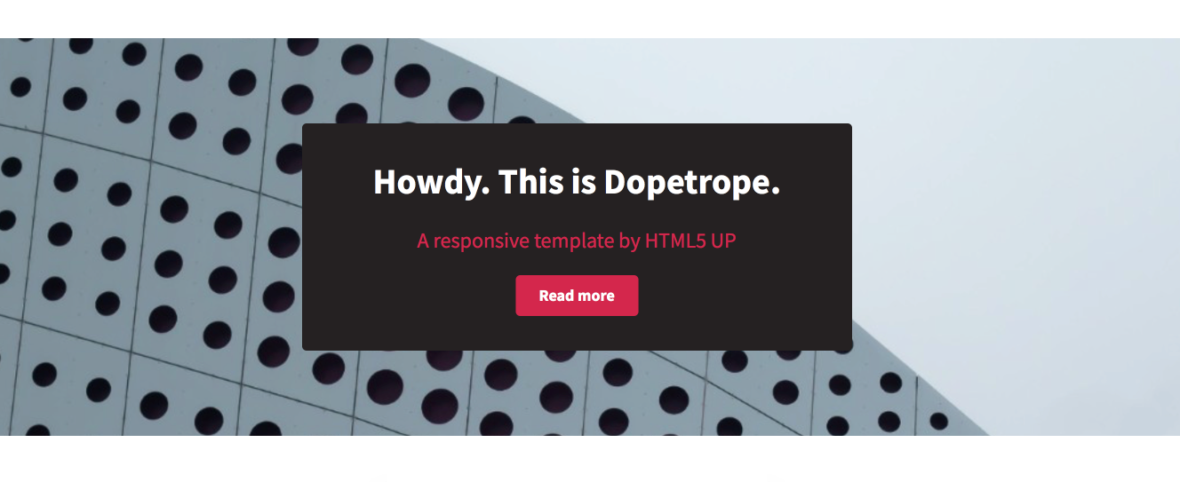
Teaser with Hero Style

Slide 41
Teaser Hero style JavaScript
/apps/l725/clientlibs/clientlib-dopetrope/components/teaser/styles/teaser.js
01
02
03
04
05
06
07
08
09
10
11
12
13
14
15
16
17
18
19
20
21
22
23
function applyComponentStyles() {
$(‘.cmp-teaser--hero .cmp-teaser’)
.not(‘[data-cmp-teaser-hero-processed]’).each(function() {
var teaser = $(this).attr(’data-cmp-teaser-hero-processed’, true),
image = teaser.find(‘.cmp-image__image’);
if (image && image.attr(‘src’)) {
hero.css("background-image", "url('" + image.attr("src") + "')");
}
});
}
applyComponentStyles();
$(".responsivegrid").on("DOMNodeInserted", applyComponentStyles);

Slide 42
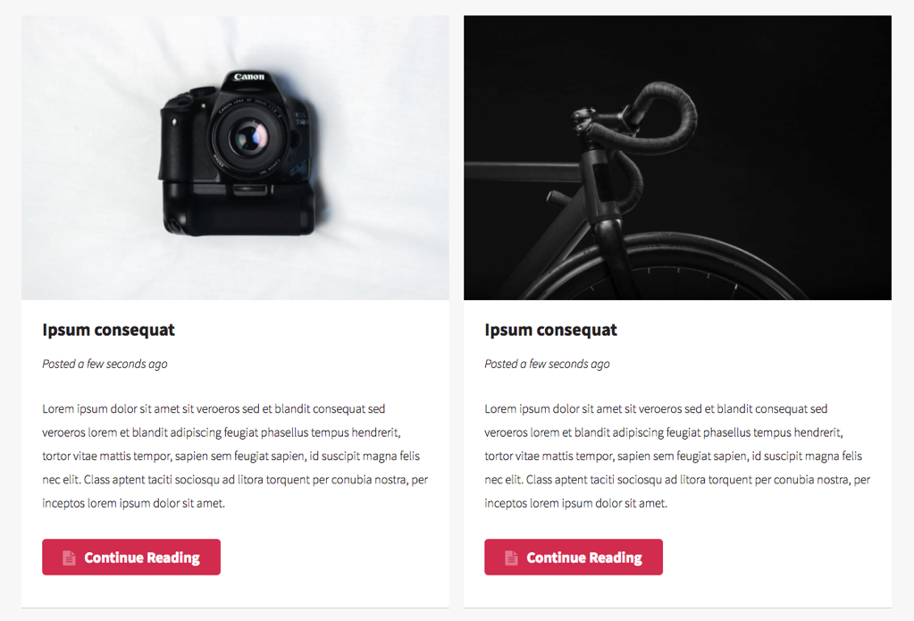
Teaser with Post Style

Slide 43
Teaser Post style JavaScript
/apps/l725/clientlibs/clientlib-dopetrope/components/teaser/styles/teaser.js
01
02
03
04
05
06
07
08
09
10
11
12
13
14
15
16
17
18
19
20
21
22
23
function applyComponentStyles() {
$(‘.cmp-teaser--post .cmp-teaser’)
.not(‘[data-cmp-teaser-posted-at-processed]’).each(function() {
var teaser = $(this).attr(’data-cmp-teaser-posted-at-processed’, true),
linkHref = teaser.find(‘.cmp-teaser__link’).attr(’href’),
dateUrl = linkHref + ‘.model.json’;
$.getJSON(dateUrl, function(jsonData) {
var dateObj = moment(jsonData.lastModifiedDate),
title = teaser.find(‘.cmp-teaser__title’),
postedAtElement = $(‘<p>’)
.addClass(‘cmp-teaser__posted-at’)
.text(‘Posted ’ + dateObject.fromNow());
title.after(postedAtElement);
});
});
}
applyComponentStyles();
$(".responsivegrid").on("DOMNodeInserted", applyComponentStyles);

Slide 44


